Slide 1


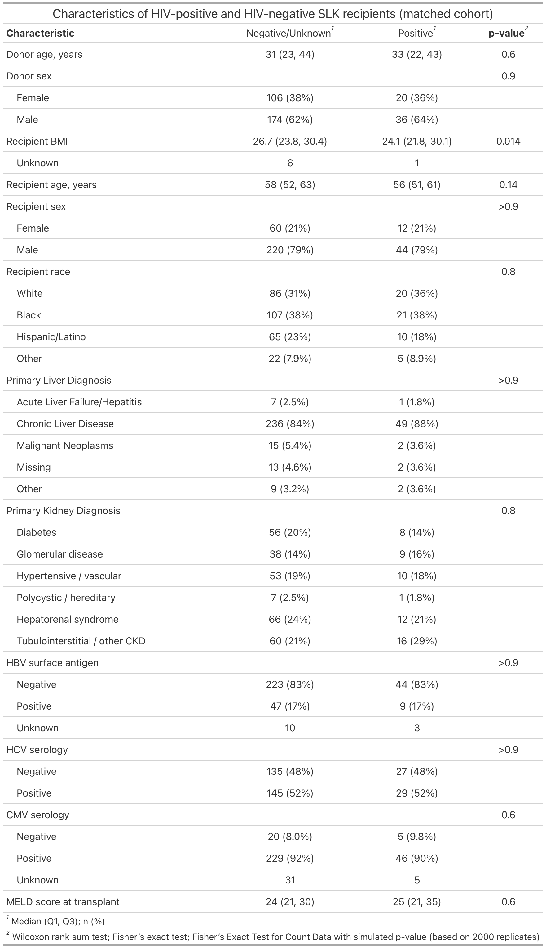
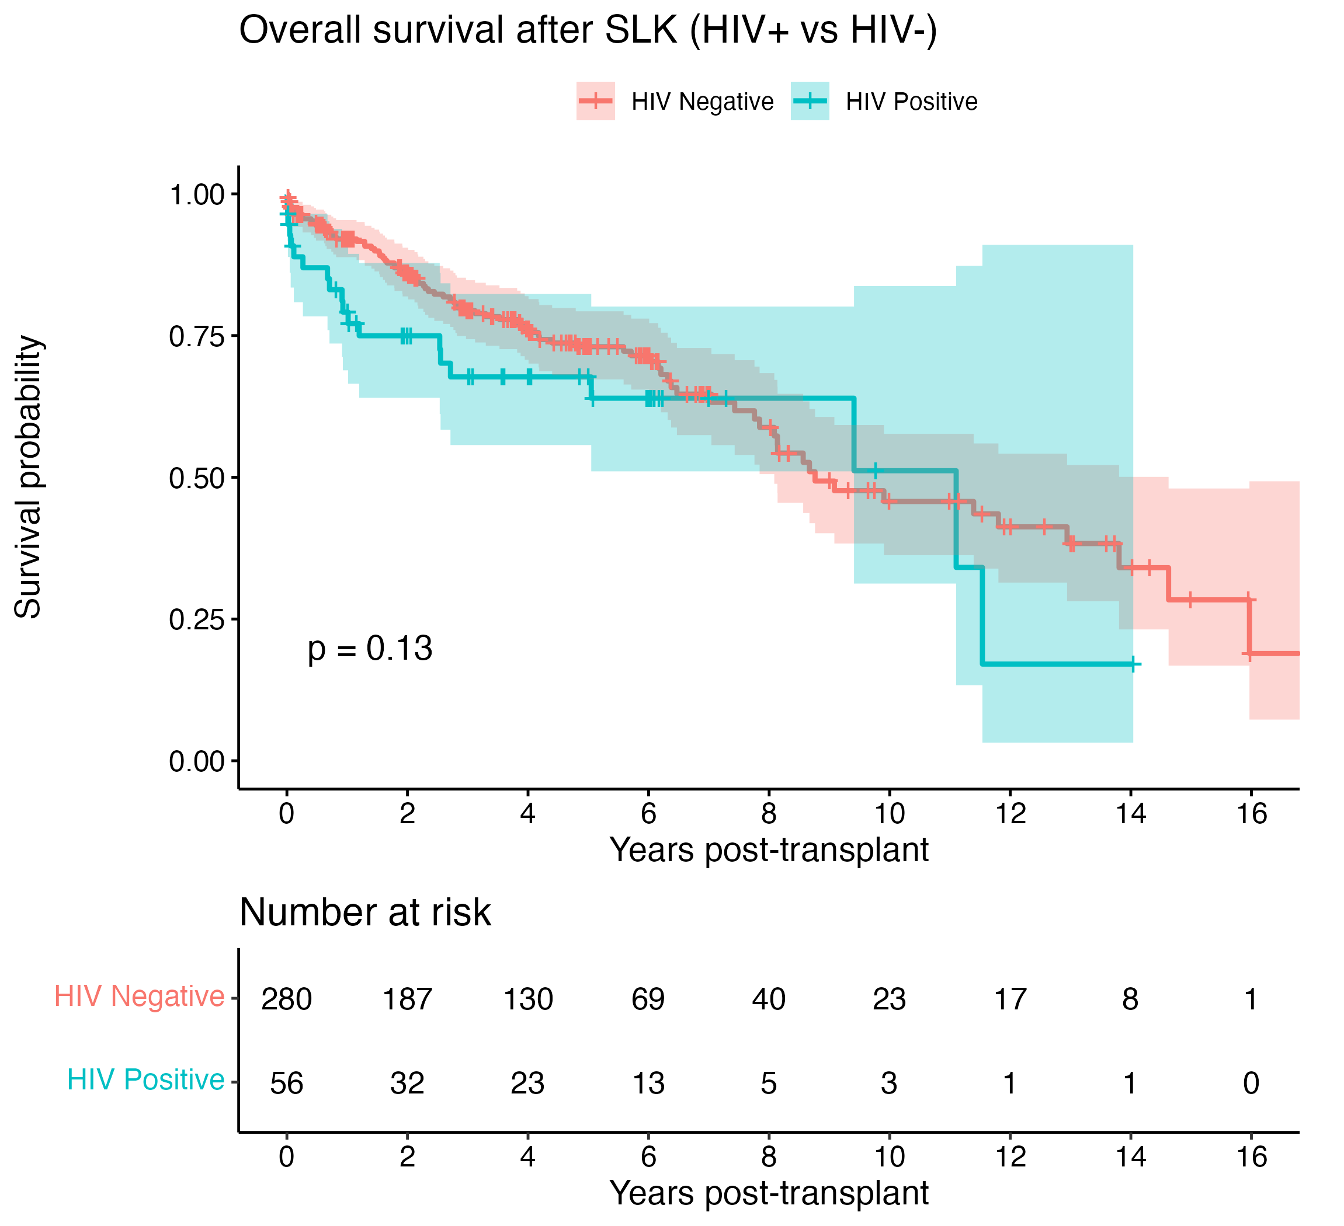
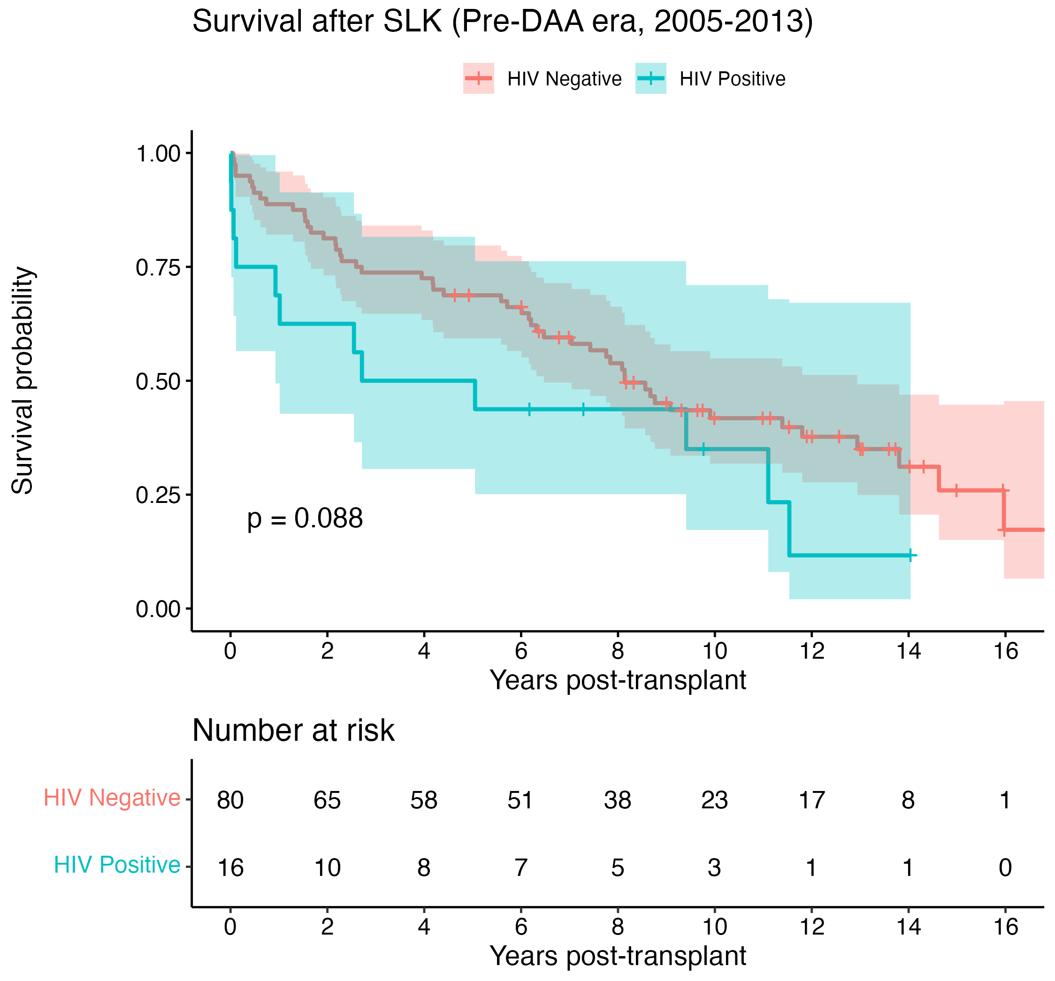
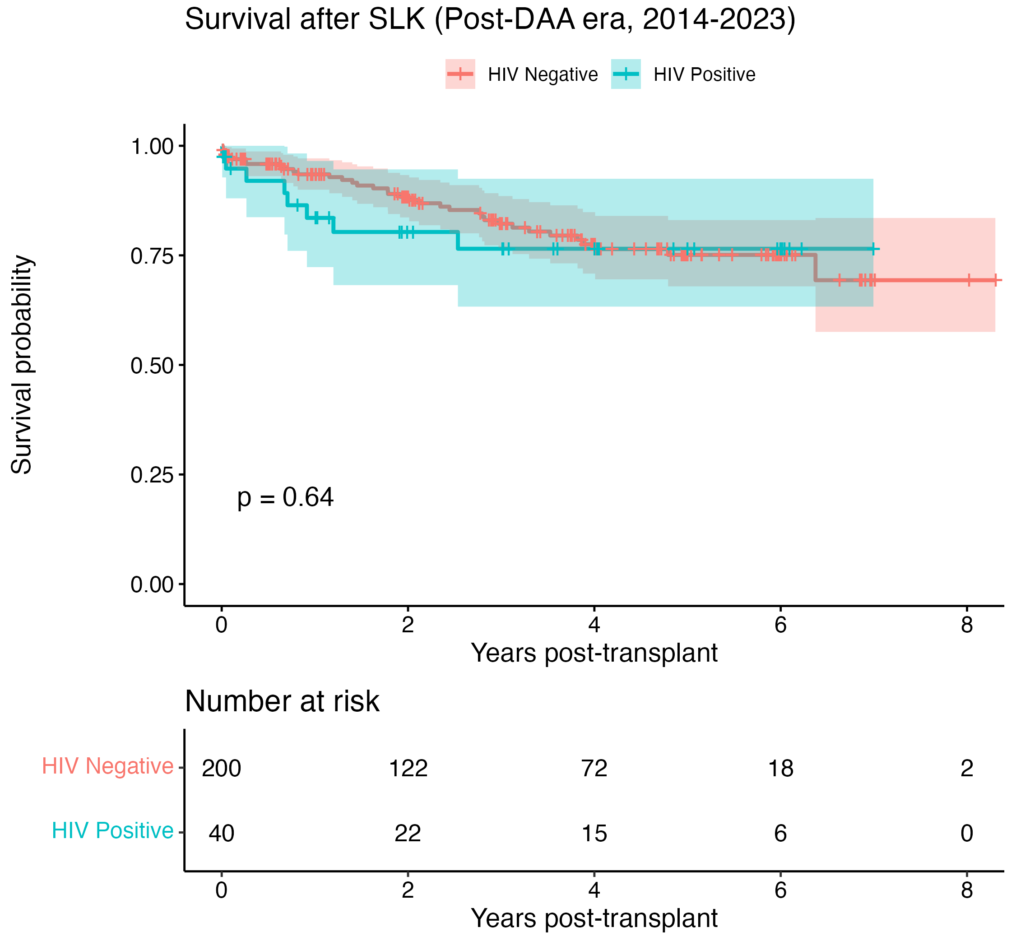
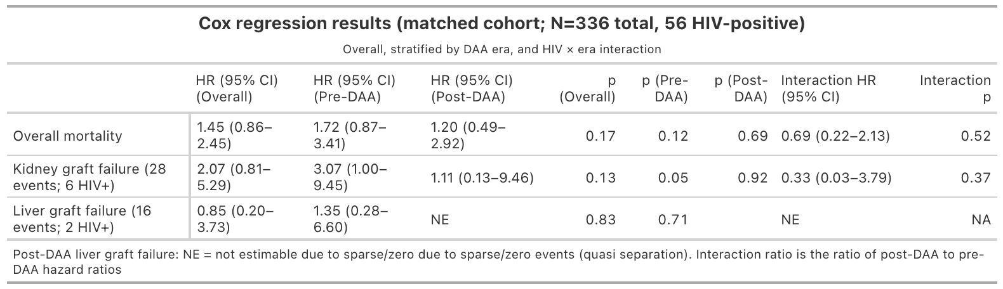
Nationwide UNOS Analysis of Mortality After Simultaneous
Liver–Kidney Transplantation in Patients With HIV, 2005–2023
Hannah Rosenthal, BS¹, Christina Tsai, MD², Jonathan Mamber Czeresnia, MD³, Vagish Hemmige, MD⁴, Clara Tow, MD⁴
¹Albert Einstein College of Medicine; ²UCLA Health, Department of Medicine, ³Rutger New Jersey Medical School, Department of Medicine, ⁴Montefiore Medical Center, Department of Medicine
Introduction
Results
Background
Objective
As people living with HIV (PLWH) live longer, they experience increasing morbidity from end-organ failure
To evaluate SLK transplant outcomes in PLWH
Simultaneous Liver-Kidney Transplantation data remain limited
Methodology
Data:
Analysis:
Outcomes of interest:
1:5 Propensity score matching was performed, based on donor characteristics, age, gender, MELD score, hepatitis C status, transplant indication, DAA era (pre- and post- 2014), and transplant year
Utilized the Spring 2023 version of UNOS SRTR data to identify patients with and without HIV who received a SLK transplant
Primary: Overall mortality
Data analysis was performed using R Version 2025.09.0+387, Vienna, Austria
Secondary: Liver and Kidney Death-Censored Graft Failure
Used Kaplan-Meier methods with log-rank testing and Cox proportional hazards regression, with analyses conducted separately by transplant era
Discussion
References
Overall Mortality
No significant difference in mortality between recipients with vs. without HIV
Graft Failure
Kidney graft outcomes comparable by HIV status across eras
Future research will compare outcomes to liver-only recipients
Marginal increase in mortality among PLWH driven by Pre-DAA era
Liver graft failure events were uncommon
Conclusion
Our results support equitable access to SLK transplantation among PLWH
Limited by small sample
Alqahtani SA, Yao FY, McDiarmid SV, et al. Outcomes of liver transplantation in patients with human immunodeficiency virus infection in the United States. JAMA Surg. 2022;157(4):e220089. doi:10.1001/jamasurg.2022.0089
Locke JE, Gustafson S, Mehta S, et al. Outcomes of simultaneous liver–kidney transplantation in people living with HIV. Am J Transplant. 2022;22(10):2465-2474. doi:10.1111/ajt.17178
Blumberg EA, Rogers CC; AST Infectious Diseases Community of Practice. Solid organ transplantation in the HIV-infected patient. Am J Transplant. 2013;13(suppl 4):169-178. doi:10.1111/ajt.12104
Ho DE, Imai K, King G, Stuart EA. MatchIt: Nonparametric preprocessing for parametric causal inference. J Stat Softw. 2011;42(8):1-28. https://cran.r-project.org/package=MatchIt
Durand CM, Bowring MG, Brown DM, et al. Advances in transplantation for people living with HIV in the modern era. Transplantation. 2024;108(3):456-465. doi:10.1097/TP.0000000000004903

